Slide 1




DreamForge Turn Your Concepts into Projects
Supervisor: Alex Keselman
Presenters: Or Yosef & Yaniv Lippa

Slide 2


Overview
01
04
Introduction
Verification
02
The Problem
05
Challenges
03
Our Solution
06
Demonstration
04
The Product

Slide 3

Introduction
In this area, more and more people are using AI features to simplify their lives across various fields.
We aim to enhance the capability of ambitious individuals to formalize their ideas into project books using AI.
The main goal is to create a fully functional website where users of any background can easily create books by simply entering their project ideas.

Slide 4




The problem:
Transforming an idea into a comprehensive project book using AI is not straightforward and often involves complex steps that can be intimidating.
Utilizing advanced AI tools for documentation generation can be expensive, limiting access for individuals or small organizations.
Many AI tools require specific technical skills or detailed input to produce meaningful results, creating a barrier for those with less experience.

Slide 5




Our solution
DreamForge is a website Ai application which allows any user with any level of experience to transfer his idea into a project book by entering their idea.
We are offering a convenient and simple user interface, where a user can enter his idea in the simplest way.
Users will be able to create a project book, view their generated book online, also download and manage each of the user’s project from the user's personal library.

Slide 6
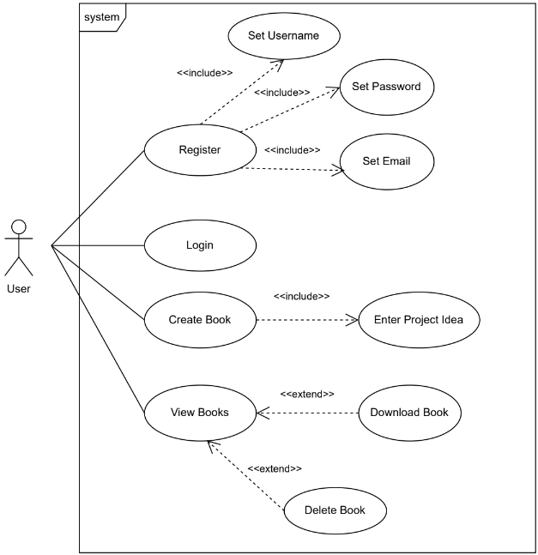

The Product
Use Case diagram:

Slide 7
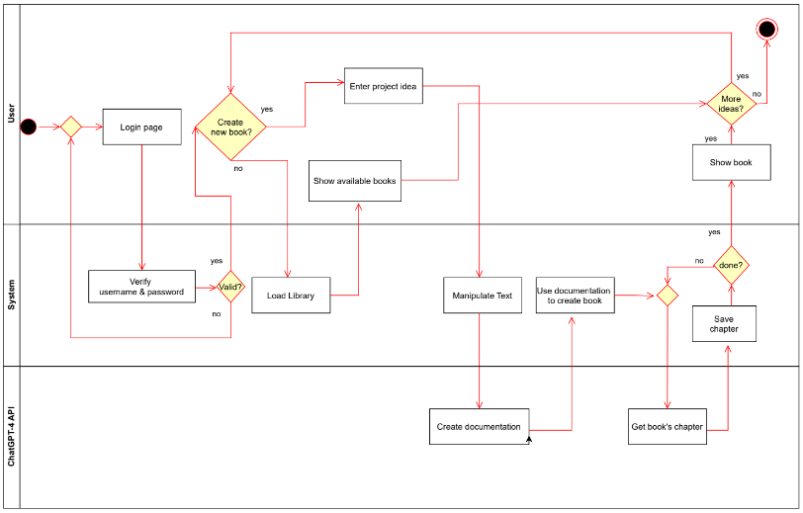
The Product
Activity diagram:

Slide 8






The Product
Architecture
API
Request content
generation
Returns generated
content
Sends user input
Stores project data
Display project data
Retrieves project data
Web
Server
Database

Slide 9

The Product
Solution Explain
The server receives the user's idea, prompts ChatGPT to refine it, and generates a comprehensive documentation file.
Once the documentation file is received, the server initiates requests to ChatGPT to generate each chapter of the project book.
For each chapter returned by ChatGPT, the server edits and incorporates it into the document. Once complete, the server saves the finalized document for the user.

Slide 10
The Product
Software instructions
React: 18.3.1
React-dom: 18.3.1
React-router-dom: 6.26.1
Node.js v21.1.0.
Mongodb: 6.8.0
mongoose: 8.6.0
Axios: 1.7.7
ExpressJS: 1.18.0
firebase: 10.13.1

Slide 11

Verification
Unit-testing
Result | Expected result | Test Subject
pass | Message: “Invalided email address” | Registration - Enter invalid email | 1
pass | Message: “Invalid character used” | Registration – Invalid character entered | 2
pass | Message: “This username already exists” | Registration – Enter already existing username | 3
pass | Message: “Wrong username or password” | Login – Enter wrong username/password | 4
pass | Message: “This user is currently logged-in” | Login – Enter an already logged-in user details | 5
pass | Message: “Must enter username and password” | Login – Login with empty username or password | 6
pass | Message: “Idea must be more then four words” | Idea submission – Enter idea with less then four words | 7
pass | Message : “Could not understand your idea” | Idea submission - Meaningless idea entered | 8
pass | Message : “Warning – your idea may be offensive” | Idea submission - Offensive text entered | 9

Slide 12
Verification
Functional-testing
Result | Expected Result | Test Subject
pass | The screen will switch to the “Idea submission” page | Login – Enter valid user details and press “Login” button | 1
pass | The screen will switch to the “Book created” page | Idea submission – Enter a valid idea and press the “Make It Real” button | 2
pass | The project book will be downloaded to the user’s computer | Book created - press the “Download Book” button | 3
pass | The created book will be shown on the screen | Book created - press the “View Book” button | 4
pass | A warning message window will appear: “Are you sure you want to remove the book?” | Bookshelf - press “Remove” button for specific book | 5
pass | The book will be removed from the bookshelf | Bookshelf (warning) - press “Yes” button after warning appear | 6
pass | The screen will return to the original bookshelf screen | Bookshelf (warning) - press “No” button after warning appear | 7
pass | The chosen book will be shown on the screen | Bookshelf - press the “ View” button for a specific book | 8
pass | The chosen book will be downloaded to the user’s computer | Bookshelf - press the “ Download” button for a specific book | 9

Slide 13

Challenges
The development of the project book required substantial guidance to effectively harness ChatGPT's capabilities
User input is unpredictable. We must accurately process the provided text to ensure the most precise project book.
Balancing the development of this project with our full-time responsibilities was challenging, but we remained committed to making progress.

Slide 14

Demonstration
https://ebraude-my.sharepoint.com/personal/yaniv_lippa_e_braude_ac_il/_layouts/15/stream.aspx?id=%2Fpersonal%2Fyaniv%5Flippa%5Fe%5Fbraude%5Fac%5Fil%2FDocuments%2FMicrosoft%20Teams%20Chat%20Files%2FDreamForgeTutorial%2Emp4&ga=1&referrer=StreamWebApp%2EWeb&referrerScenario=AddressBarCopied%2Eview%2Ebca6f69a%2Db487%2D4989%2Db624%2D7b36c8b2b9e3

Slide 15

Thank you
For listening
Any Questions?

